Slide 1

By
Mrs. Kinyirira Bartha Alexandra Nantongo

Slide 2

This course introduces the concepts and issues related to securing information systems and the development of policies to implement information security controls.
Topics include the historical view of networking and security, security issues, trends, security resources, and the role of policy, people, and processes in information security.
Upon completion, students should be able to identify information security risks, create an information security policy, and identify processes to implement and enforce policy.

Slide 3

To introduce students on how to manage information within the organization
To enable students to understand the legal implications of misuse of information technology systems
To allow students relate information security to business mission, objectives and goals

Slide 4
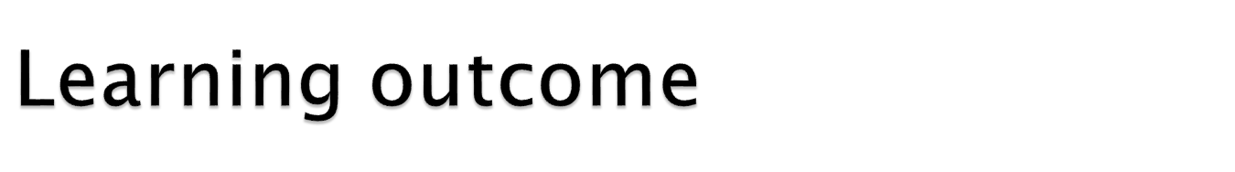
Student should be able to
Explain the security concepts and principles like confidentiality, integrity, availability, trust, privacy, and ethical issues
Practice different algorithms of cryptography and digital signature
Comprehend the use of security issues in e-commerce, operating systems, database, and networks
Assess the impact of the system security or lack of security on the society
Explain the security engineering life cycle activities from security requirements to security testing

Slide 5

Guide to security essentials (CISSP)
Mark Giampa, Networking security fundamental, third edition
Nina Godbole, Information Systems Security: Security Management, Metrics, Frameworks and Best Practices, (2009) Wiley India Pvt. Ltd,
Other information security text books

Slide 6

Mission statements often include the following information:
Aim(s) of the organization
The organization's primary stakeholders: clients/customers, shareholders, congregation, etc.
How the organization provides value to these stakeholders, eg by offering specific types of products and/or services
A declaration of an organization's sole core purpose. A mission statement answers the question, "Why do we exist?"
According to Bart, the commercial mission statement consists of 3 essential components:
        Key market – who is your target client/customer? (generalize if needed)
        Contribution – what product or service do you provide to that client?
        Distinction – what makes your product or service unique, so that the client would choose you?

Slide 7
McDonald's - "To provide the fast food to customers, prepared in the same high-quality manner world-wide that has consistent taste, serving time, and price in a low-key décor and friendly atmosphere
    Key Market: The fast food customer world-wide
    Contribution: tasty and reasonably-priced food prepared in a high-quality manner
    Distinction: delivered consistently (world-wide) in a low-key décor and friendly atmosphere.
Courtyard by Marriott - "To provide economy and quality minded travelers with a premier, moderate priced lodging facility which is consistently perceived as clean, comfortable, well-maintained, and attractive, staffed by friendly, attentive and efficient people“
    Key Market: economy and quality minded travelers
    Contribution: moderate priced lodging
    Distinction: consistently perceived as clean, comfortable, well-maintained, and attractive, staffed by friendly, attentive and efficient people

Slide 8
“Help civilize the electronic frontier; to make it truly useful and beneficial not just to a technical elite, but to everyone, and to do this in a way which is in keeping with our society's highest traditions of the free and open flow of information and communication.” (Electronic Frontier Foundation)
“Empower and engage people around the world to collect and develop educational content under a free license or in the public domain, and to disseminate it effectively and globally.” (Wikimedia Foundation)
“Promote professionalism among information system security practitioners through the provisioning of professional certification and training.” (ISC)

Slide 9
Statements of activities or end-states that the organization wishes to achieve.
Support the organization’s mission and describe how the organization will fulfill its mission.
Observable and measurable.
Do not necessarily specify how they will be completed, when, or by whom.
Example Objectives
  “Obtain ISO 27001 certification by the end of third quarter.”
  “Reduce development costs by twenty percent in the next financial year.”
  “Complete the integration of CRM and ERP systems by the end of November.”

Slide 10

A goal is a desired result a person or a system envisions/visualizes, plans and commits to achieve
A personal or organizational desired end-point in some sort of assumed development.
Many people endeavor to reach goals within a finite time by setting deadlines.
It is roughly similar to purpose or aim,

Slide 11
Specify specific accomplishments that will enable the organization to meet its objectives.
Measurable, observable, objective, support mission and objectives
Goals and objectives are synonyms

Slide 12

Goals | Objectives
Broad | Narrow.
General intentions | Precise
Intangible | Tangible
Abstract | Concrete
Can't be validated | Can be validated

Slide 13
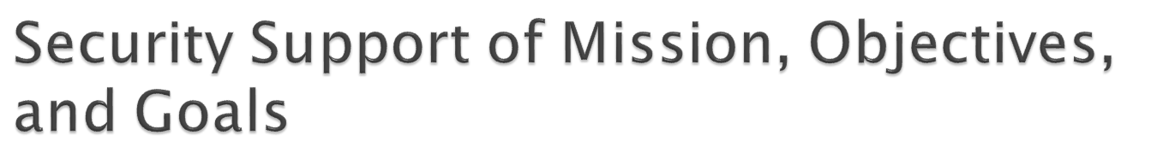
Our role is to reduce risk through proper activities and controls that protect assets
Protect the organization and its ability to perform its mission, not just its IT assets
Be aware of mission, objectives, goals
We need the support of senior management
To get priorities and resources
To become involved in key activities

Slide 14

“The process of determining the maximum acceptable level of overall risk to and from a proposed activity,
Then using risk assessment techniques to determine the initial level of risk and, if this is excessive,
Developing a strategy to restructure appropriate individual risks until the overall level of risk is reduced to an acceptable level.”
Two steps
Risk assessments
Risk treatment

Slide 15

For a given scope of assets, identify:
Vulnerabilities/weakness/ liability/exposure
Threats ( hazard/ danger/ warning)
Threat probability (Low / medium / high)
Impact (Low / medium / high)
Countermeasures

Slide 16
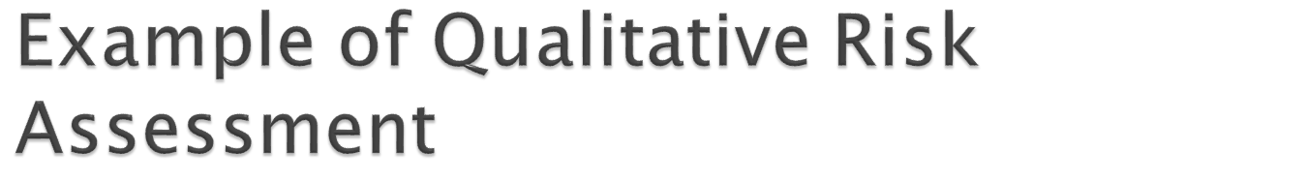
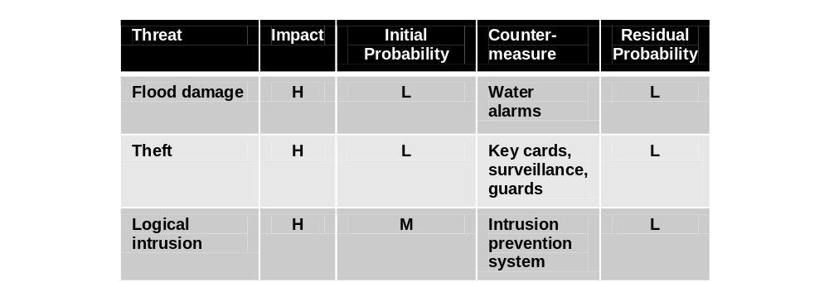

Slide 17

Extension of a qualitative risk assessment. Metrics for each risk are:
  Asset value: replacement cost and/or income derived through the use of an asset
  Exposure Factor (EF): portion of asset's value lost through a threat (also called impact)
  Single Loss Expectancy (SLE) = Asset ($) x EF (%)
  Annualized Rate of Occurrence (ARO)
  Probability of loss in a year, %
  Annual Loss Expectancy (ALE) = SLE x ARO

Slide 18

Example one;
Theft of a laptop computer, with the data encrypted
Asset value: $4,000
Exposure factor: 100%
SLE = $4,000 x 100% = $4,000
ARO = 10% chance of theft in a year
ALE = 10% x $4,000 = $400

Slide 19
Example two;
Dropping a laptop computer and breaking the screen
Asset value: $4,000
Exposure factor: 50%
SLE = $4,000 x 50% = $2,000
ARO = 25% chance of theft in a year
ALE = 25% x $2,000 = $500

Slide 20

Goal: reduction of ALE (or the qualitative losses)
Impact of countermeasures:
  Cost of countermeasure
  Changes in Exposure Factor (EF)
  Changes in Single Loss Expectancy (SLE)

Slide 21

Replacement and repair costs of assets may vary by location
Exposure Factor may vary by location
Impact may vary by location

Slide 22

NIST 800-30, Risk Management Guide for Information Technology Systems
OCTAVE (Operationally Critical Threat, Asset, and Vulnerability Evaluation)
FRAP (Facilitated Risk Analysis Process) – qualitative pre-screening
Spanning Tree Analysis – visual, similar to mind map

Slide 23
One or more outcomes from a risk assessment
Risk Acceptance
    “yeah, we can live with that”
Risk Avoidance
    Discontinue the risk-related activity -- the most extreme form of risk treatment
Risk Reduction (also called Risk Mitigation)
    Using countermeasures such as firewalls, IDS systems, etc., to reduce risks
Risk Transfer
    Buy insurance

Slide 24
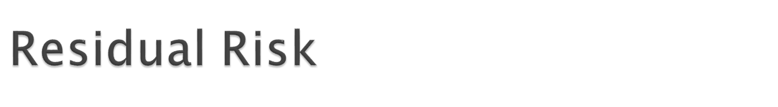
After risk treatment, some risk remains
Risk can never be eliminated entirely
The remaining risk is called Residual Risk

Slide 25

Security controls
CIA Triad
Defense in depth
Single points of failure
Fail open, fail closed
Privacy
ISO 27001

Slide 26
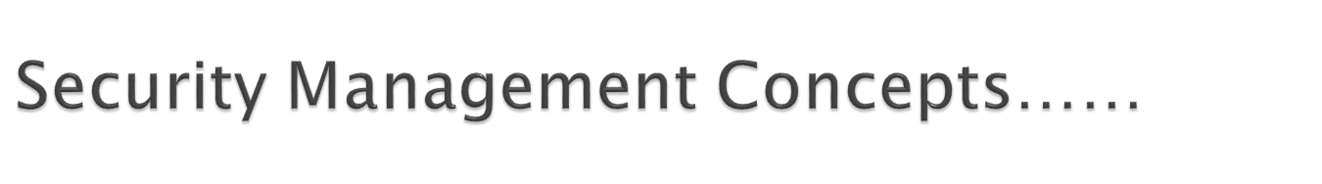
1. ISO 27001
Standard for Information Security Management System
Plan-Do-Check-Act cycle
  Plan = define requirements, assess risks, decide which controls are applicable
  Do = implement and operate the IS
  Check = monitor and review the IS
  Act = maintain and continuously improve the IS
  Documents and records are required

Slide 27

2. Security Controls
Detective (records events)
Deterrent (scares evil-doers away)
Preventive (stops attacks)
Corrective (after an attack, prevents another attack)
Recovery (after an attack, restores operations)
Compensating (substitutes for some other control that is inadequate)

Slide 28
3. CIA: Confidentiality, Integrity, Availability
The three pillars of security: the CIA Triad (harmony)
  Confidentiality: information and functions can be accessed only by properly authorized parties
  Integrity: information and functions can be added, altered, or removed only by authorized persons and means
  Availability: systems, functions, and data must be available on-demand according to any agreed-upon parameters regarding levels of service

Slide 29
4. Defense in Depth
A layered defense in which two or more layers or controls are used to protect an asset
  Heterogeneity: the different controls should be different types, so as to better resist attack
  Entire protection: each control completely protects the asset from most or all threats
  Example: antivirus on the email gateway, and also on the workstations
Defense in depth reduces the risks from
  Vulnerability of a single device
  Malfunction of a single device
  Fail open of a single device

Slide 30

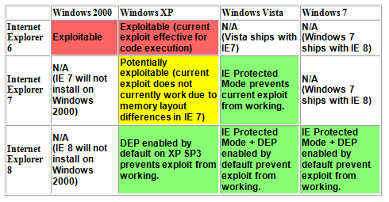
Defense in Depth Example
The IE 0day used against Google

Slide 31
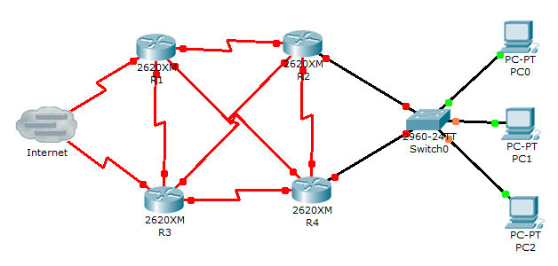
5. Single Points of Failure
A single point of failure (SPOF)
Failure of a single component results in the failure of the entire system

Slide 32
6. Fail Open / Fail Closed / Fail Soft
When a security mechanism fails, there are usually two possible outcomes:
  Fail open – the mechanism permits all activity
  Fail closed – the mechanism blocks all activity
  Fail Soft -- shutting down failed systems, preserving some functionality
    Example: A server with a UPS and a shutdown script
Principles
  Different types of failures will have different results
  Both fail open and fail closed are undesirable, but sometimes one or the other is catastrophic
  Security devices generally fail closed

Slide 33
7. Privacy
Defined: the protection and proper handling of sensitive personal information
Requires proper technology for protection
Requires appropriate business processes and controls for appropriate handling Issues
    Inappropriate uses
    Unintended disclosures to others
Personally Identifiable Information (PII)
      Name,
      Phone number
      Driver's license number
      Credit card numbers etc

Slide 34

Executive oversight
Governance
Policy, guidelines, standards, and procedures
Roles and responsibilities
Service level agreements
Secure outsourcing
Data classification and protection
Certification and accreditation
Internal audit

Slide 35

Security Executive Oversight
Executives must support security activities
  Support and enforcement of policies
  Allocation of resources
  Prioritization of activities
  Support of risk treatment

Slide 36
2. Governance
Defined: “Security governance is the set of responsibilities and practices exercised by the board and executive management with the goal of providing strategic direction, ensuring that objectives are achieved, ascertaining that risks are managed appropriately and verifying that the enterprise's resources are used responsibly.”
The process and action that supports executive oversight
  Steering committee oversight
  Resource allocation and prioritization
  Status reporting
  Strategic decisions

Slide 37
3. Policy, guidelines, standards, and procedures
Policies
  Constraints (restrictions) of behavior on systems and people
  Specifies activities that are required, limited, and forbidden
Example
  Information systems should be configured to require good security practices in the selection and use of passwords
Policy Standards
  ISO 27002:2005
  SANS Security Policy Project

Slide 38

Requirements
  Required characteristics of a system or process
  Often the same as or similar to the policy
  Specifies what should be done, not how to do it
Example
  Information systems must enforce password quality standards and reference a central authentication service, such as Active Directory.

Slide 39

Guidelines: defines how to support a policy
  Example: Passwords must not be dictionary words
Standards: what products, technical standards, and methods will be used to support policy
  Examples
  All fiber optic cables must be Corning brand
  Passwords must be at least 8 characters
Procedures: step by step instructions

Slide 40
4. Security Roles and Responsibilities
Formally defined in security policy and job descriptions
These need to be defined:
  Ownership of assets
  Access to assets
  Use of assets: employees are responsible for their behavior
  Managers responsible for employee behavior

Slide 41
5. Service Level Agreements
SLAs define a formal level of service
SLAs for security activities
  Security incident/ ocurrance response
  Security alert / advisory delivery
  Security investigation
  Policy and procedure review

Slide 42
6. Secure Outsourcing
Outsourcing risks
  Control of confidential information
  Loss of control of business activities
  Accountability – the organization that out sources activities is still accountable for their activities and outcomes

Slide 43
7. Data Classification and Protection
Components of a classification and protection program
  Sensitivity levels
    “confidential”, “restricted”, “secret”, etc.
  Marking procedures
    How to indicate sensitivity on various forms of information
  Access procedures
  Handling procedures
    E-mailing, faxing, mailing, printing, transmitting, destruction

Slide 44
8. Certification and Accreditation
Two-step process for the formal evaluation and approval for use of a system
  Certification is the process of evaluating a system against a set of formal standards, policies, or specifications.
  Accreditation is the formal approval for the use of a certified system
  for a defined period of time (and possibly other conditions).

Slide 45
9. Internal Audit
Evaluation of security controls and policies to measure their effectiveness
  Performed by internal staff
  Objectivity is of vital importance
  Formal methodology
  Required by some regulations,

Slide 46
10. Security Strategies
Management is responsible for developing the ongoing strategy for security management
Past incidents can help shape the future
  Incidents
  SLA performance
  Certification and accreditation
  Internal audit

Slide 47

Hiring practices and procedures
Periodic performance evaluation
Disciplinary action policy and procedures
Termination procedures

Slide 48
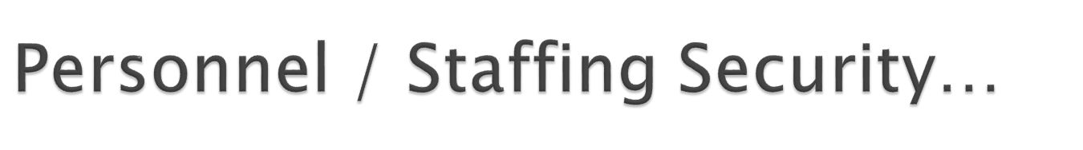
1. Hiring Practices and Procedures
Effective assessment of qualifications
Background verification (prior employment, education, criminal history, financial history)
Non-disclosure agreement (NDA)
Non-compete agreement
Intellectual property agreement
Employment agreement
Employee Handbook
Formal job descriptions

Slide 49
2. Termination
Immediate termination of all logical and physical access
Change passwords known to the employee
Recovery of all company assets
Notification of the termination to affected staff, customers, other third parties
And possibly: code reviews, review of recent activities prior to the termination

Slide 50
3. Work Practices
Separation of duties
  Designing sensitive processes so that two or more persons are required to complete them
Job rotation
  Good for cross-training, and also reduces the likelihood that employees will conspire /scheme/plot for personal gain
Mandatory vacations
  Detect / prevent irregularities that violate policy and practices

Slide 51
4. Security Education, Training, and Awareness
Training on security policy, guidelines, standards
Upon hire and periodically thereafter
Various types of messaging
  E-mail, intranet, posters, flyers, trinkets, training classes
Testing – to measure employee knowledge of policy and practices

Slide 52

Code of ethics
  Protect society, the commonwealth, and the infrastructure.
  Act honorably, honestly, justly, responsibly, and legally.
  Provide diligent and competent service to principals.
  Advance and protect the profession.

